Slide 1
Restful Web APIs

Slide 2
Agenda
Kode eksempel
MVC

Slide 3
Kode eksempel!
Node.js web server
Express
Routes
Middleware
Persistence

Slide 4
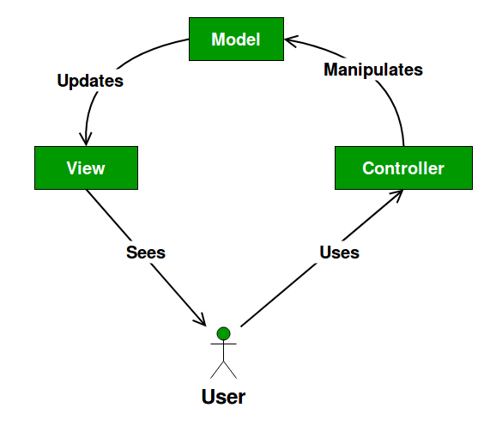
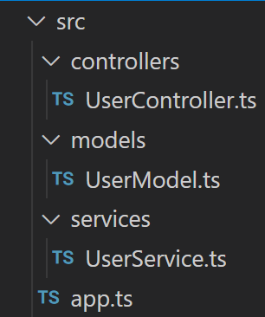
MVC
Strukturelt
Views
Templating

